Slide 1
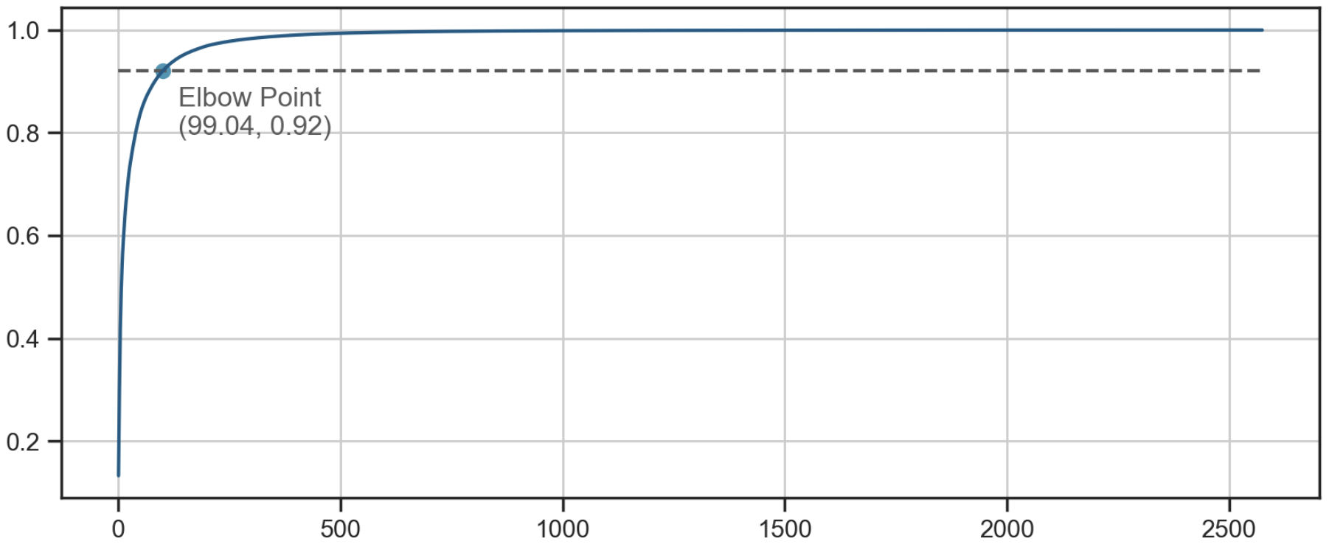
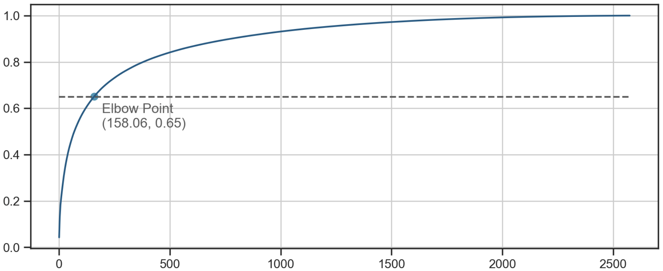
Users with high trade values or frequencies constitute only a small segment of the market
Cumulative trade values Percent
Trade values
% of total
Label
Top 100 users
High trade values
92%
Trade
values
Others
Low trade values
8%
Top 160 users
High trade times
65%
~90% of total trade values comes from only Top 100 users
Trade
times
Others
Low trade times
35%
Low Group
User index
Sorted by trade values
Trade values
High Group
Cumulative trade times Percent
High
Low
High
73
27
2388
Trade
times
87
2388
187
Low
Conclusions
The High Group comprises 187 users, forming the premier segment
Further segmentation is necessary for the Low Group, as it encompasses a substantial number of users totaling 2,388
~70% of total trade times comes from only Top 160 users
User index
Sorted by trade times

Slide 2
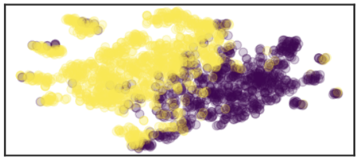
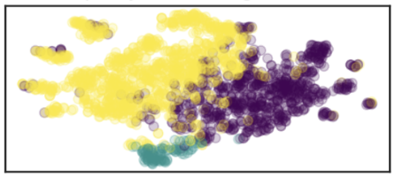
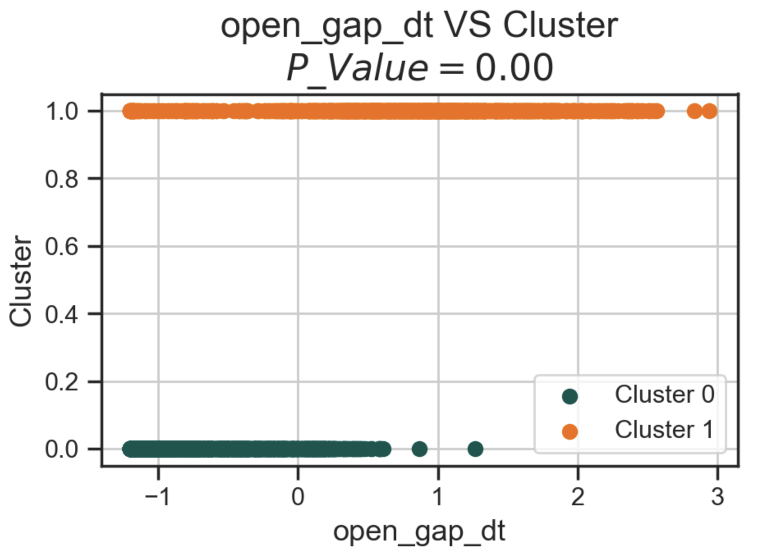
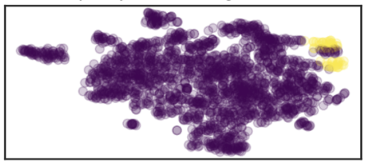
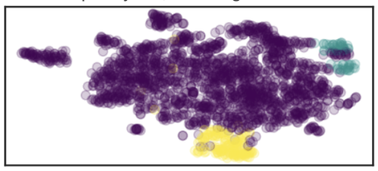
Building a workflow to user segment
Cluster visualization using different cluster method
Get user segment based on the cluster result
Figure
Assign labels to the cluster outcomes to categorize users into distinct segments for more detailed analysis
2 clusters
Select meaningful features based on decision tree classifier
K-Prototypes
Decision tree classifier model is capable of autonomously identifying and providing the important features.
3 clusters
Build commercial insight based on statistical test
2 clusters
K-Prototypes
Conduct non-parametric tests on the identified key features to determine if there are significant differences across the segments
3 clusters

